Slide 1
Heineken
Income Statement

Slide 2
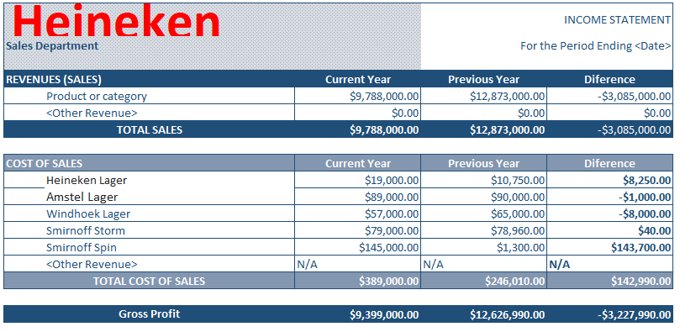

Slide 3
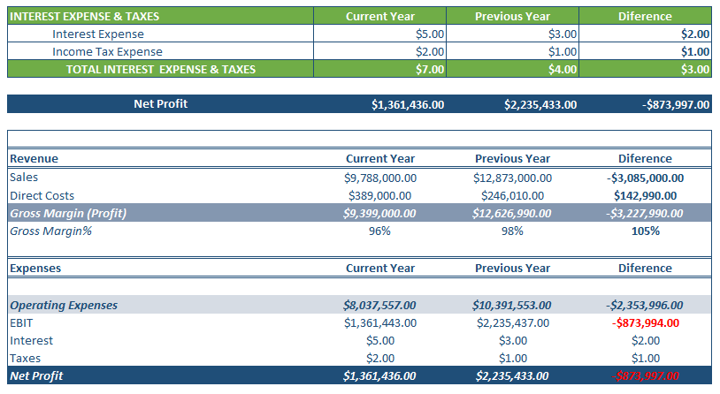

Slide 4
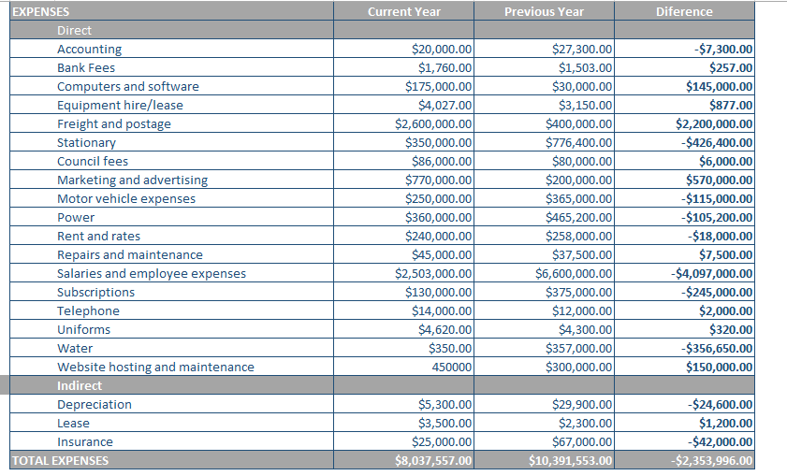

Slide 5
Direct Expenses
Selling/General/Admin = 7,500. The large allocation was accorded due to the need for attention to detail and compliance with government regulations.
Computers and software = 1,750. Most of the computers and software used in the previous year were still in good shape. A few upgrades were done.
Bank Fees = 1,760. This expense many a times goes unnoticed, and is considered petty. Developments in online transactions could reduce this cost.
Equipment hire/lease = 25,000 The need for buying equipment rather than hiring came up.
Freight and postage = 1,200,000. The cost was high, but also signified an increase in exports
Repairs and maintenance = 45,000. Depicted the need to purchase new equipment.

Slide 6
Indirect Expenses
Depreciation = 3,194. The depreciation of beer was notably high, due to competition.
Lease = 2,961 Companies in foreign land were operating on leased properties.
Insurance = 2,500 There was a substantial decrease from previous year
Subscriptions = 128 There was a need for better advertisements, software and other billed services.
Shipping = 2,600 Closure of companies in the country led to increased shipping.

